Slide 1
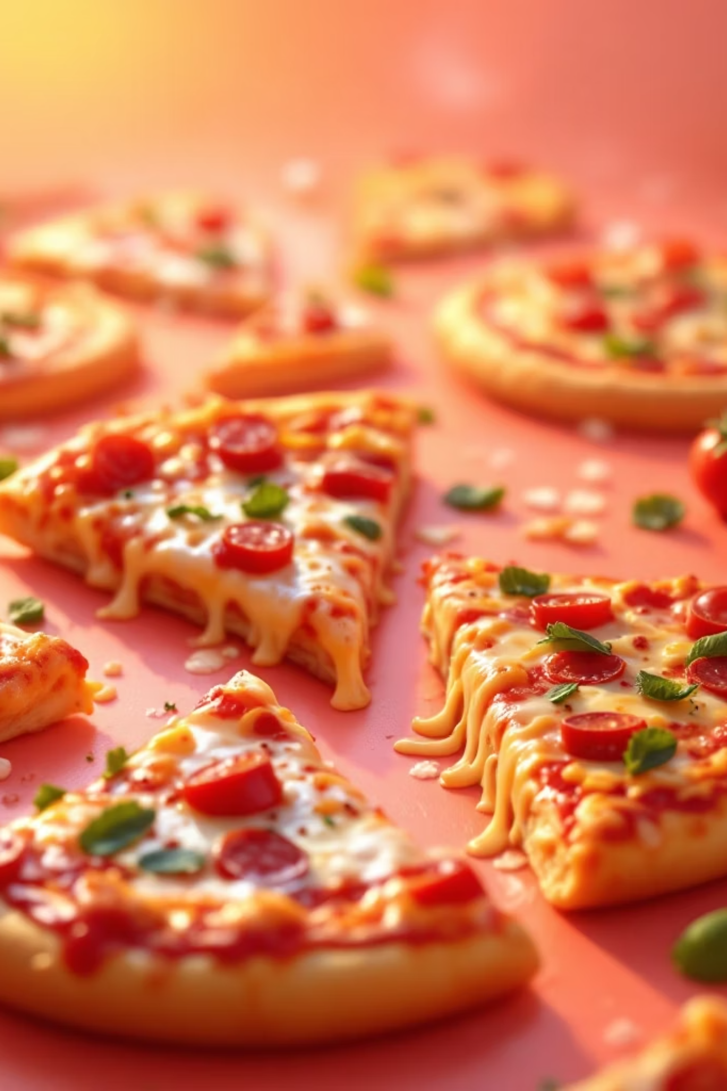
Pizza Sales Analytics
Data-driven insights for revenue growth and inventory optimization

Slide 2


BUSINESS CHALLENGE
Understanding Sales Performance
Key Questions
Which pizzas drive revenue?
When do customers order most?
What sizes and categories perform best?
How to optimize inventory and promotions?

Slide 3
Business & Analytical Goals
Increase Revenue
Improve Forecasting
Drive total sales through data-driven decisions
Predict demand patterns accurately
Optimize Menu
Boost Satisfaction
Enhance product offerings based on performance
Better menu planning for customer needs

Slide 4
Key Performance Metrics
$817K
$38
50K
21K
Total Revenue
Avg Order Value
Pizzas Sold
Total Orders
Overall sales performance
Per transaction revenue
Total units delivered
Customer transactions
2.3
Pizzas Per Order
Average order size

Slide 5
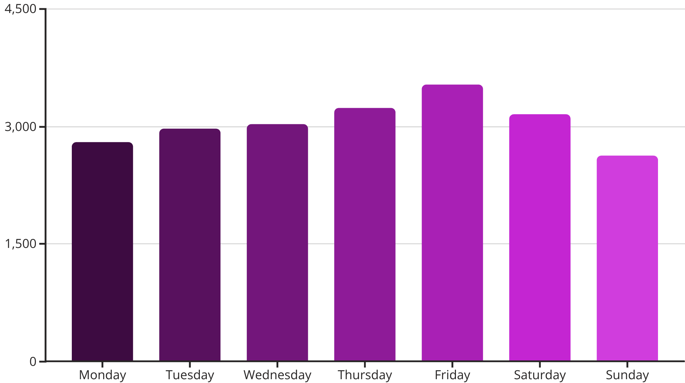
Order Trends Analysis
Peak Days
Friday leads with highest order volume, followed by Thursday and Saturday. Weekend planning crucial for inventory.
Monthly Patterns
July peaks at 1,935 orders. January lowest at 1,845. Seasonal trends inform staffing and supply.

Slide 6
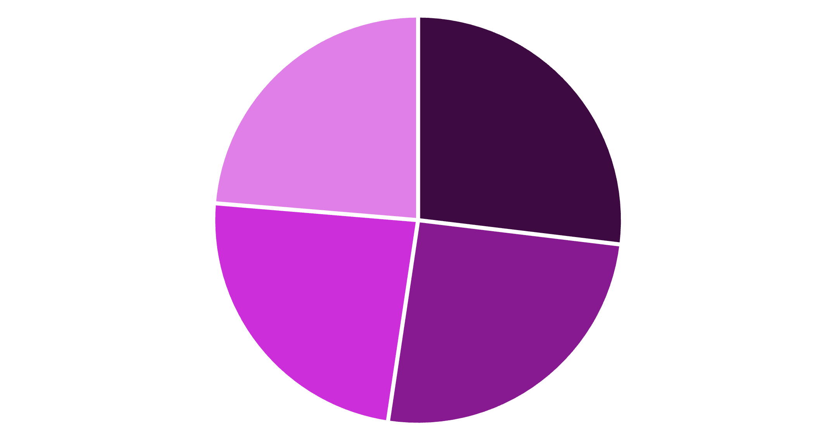
Sales by Category
Balanced Portfolio
Classic pizzas lead at 26.91%, but all categories perform within 3% range.
Size Distribution
Large: 45.89% of sales
Medium: 30.49%
Small: 21.77%
Large size dominates customer preference
Classic
Supreme
Chicken
Veggie

Slide 7
Top 5 Best Sellers
Thai Chicken Pizza
1
Revenue leader driving sales
Barbecue Chicken
2
Strong customer favorite
California Chicken
3
Consistent performer
Classic Deluxe
4
Traditional choice
Spicy Italian
5
Popular specialty

Slide 8

Bottom 5 Performers
Low Revenue Items
Brie Carre Pizza
Mediterranean Pizza
Calabrese Pizza
Spinach Supreme
Soppressata Pizza
Consider menu optimization or promotional strategies for underperformers

Slide 9
Data Analysis Approach
Data Collection
1
Pizza sales dataset with order details, categories, sizes, and pricing
2
SQL Analysis
Calculated KPIs, trends, and performance metrics using queries
Data Cleaning
3
Removed duplicates, validated data types, ensured quality
4
Power BI Visualization
Created interactive dashboards for insights and decision-making

Slide 10

Key Takeaways
Promote Winners
Peak Planning
Size Strategy
Prioritize large pizza inventory
Focus marketing on top 5 pizzas
Staff and stock for Friday-Saturday rush
Menu Review
Optimize or remove bottom performers

